Slide 1
TRAVEL BEHAVIOR
ANALYSIS
Mani Botla

Slide 2
Introduction
Purpose : To uncover travel behavior patterns and booking strategies, with the goal of helping a travel platform optimize it’s marketing strategies and user experience.
Beneficiaries include:
Travel Platforms: They can improve personalization and product offerings.
Marketing teams : Target high-value segments more effectively.
Hospitality providers : Align offers with regional booking behaviors.

Slide 3
QUESTIONS
How do trip duration and number of cities visited vary by booker country?
During which months is multi-city travel most and least popular?
How do spontaneous booking rates differ by device class, and are mobile users more likely to make last-minute travel decisions?
Which destination combinations are most frequently booked together?
Are there regional differences in trip characteristics (duration, complexity, planning behavior) that might suggest varying planning behaviors?
Which booking countries have the longest average stay durations?
Which referral channels drive the highest-value bookings in terms of stay duration?

Slide 4
METHODOLOGY
Dataset :
-bookingcom/ml-dataset-mdt: Multi Destination Trips dataset for research purposes - fully anonymized, sampled, limited
-Travel booking dataset { train_set_cleaned.csv} containing records of user trips.
Source : CSV file {dataset is cleaned and prepared for analysis}.
Each utrip_id represents one traveler’s complete journey.
Key features:
Booker_country, hotel_country, device_class, affiliate_id, checkin, checkout, stay_duration, city_id
Tools used :
Jupyter Notebook
Python Packages : pandas, NumPy, seaborn, matplotlib

Slide 5
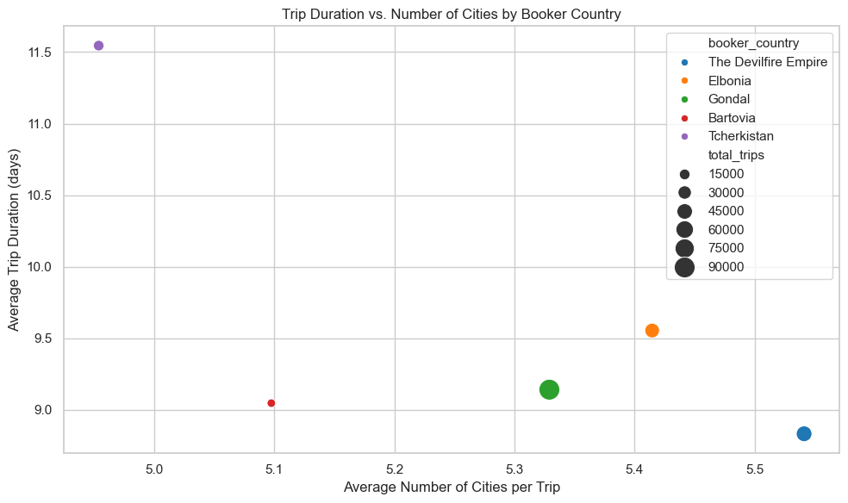
Trip duration VS number of cities visited by booker country?
- The Devilfire Empire shows the highest average number of cities per trip with a moderate trip duration .
- Bartovia has the lowest average number of cities.
- Tcherkistan stands out with the longest average trip duration approx. 11.5 days.

Slide 6
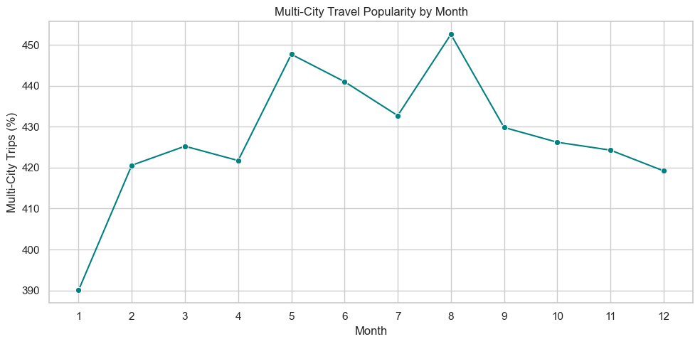
Multi-city travel popularity by Month
-During August to September months multi-city travel is most popular and it gradually decreases by december because of colder conditions.

Slide 7
RESULTS
Trip Duration by Country:
Tcherkistan : longest stays (~ 11.5 days)
Devilfire Empire : Most cities per trip
Seasonality: Summer months see peak multi-city travel.
Device Insights : Mobile users book more last-minute trips compared to desktop users.
Destination Patterns: Certain city-pairs are frequently booked together, suggesting corridor routes.
Affiliate Channels: Some referral sources generate longer stays and higher-value bookings.

Slide 8
FUTURE WORK
Predictive Modeling : Forecast spontaneous bookings using device type and seasonality.
Segmentation: Cluster travelers into types ( for example, “Weekend Explorers” vs. “long trip Travelers”).
Pricing Analysis: Study discounts and promotions impact on trip duration.
Recommendation System: Prototype itinerary suggestions based on observed patterns.

Slide 9
Appendix:
Documentation :
The notebook is well structured with sections : Imports, data loading, analysis, results and the respective additional steps.
Analysis confirmed original questions and generated hypotheses about the travel patterns.
Additional plots: additional scatter plots, bar charts etc are included.

Slide 10
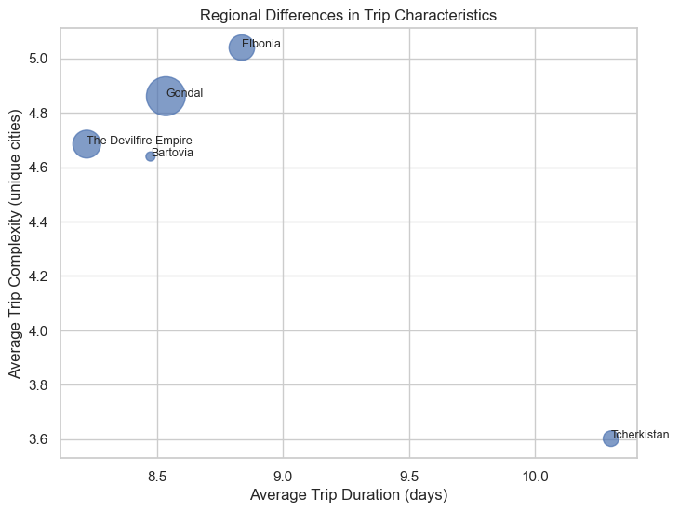
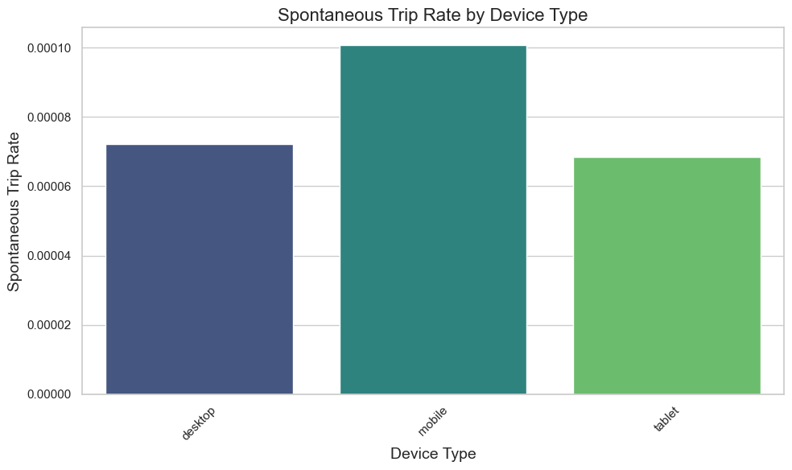

Slide 11
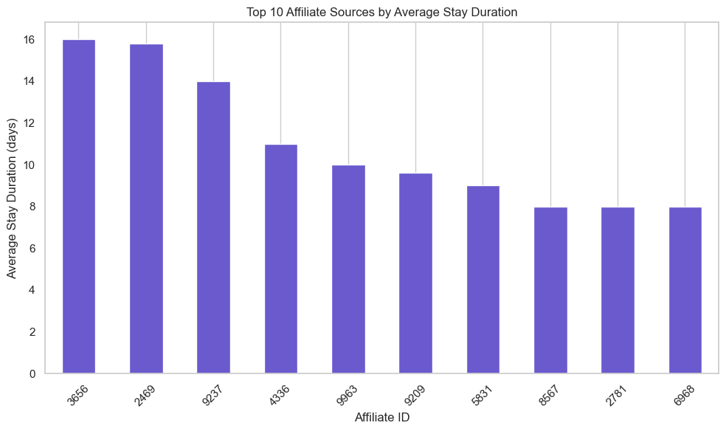
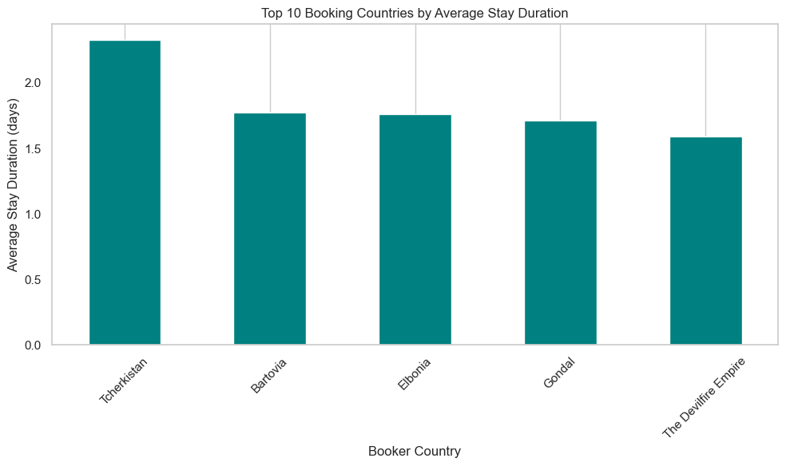

Slide 12
THANK YOU

